Slide 1

Conditional Branching (2)
Teacher Gao Algorithm Competition Training Camp

Slide 2
Example - Determining leap years
int year;
cin >> year;
if (year is divisible by 400 or year is divisible by 4 but not divisible by 100 )
cout << "yes";
else
cout << "no";
Enter an integer to represent the year and determine whether it is a leap year.
If it is a leap year, output yes , otherwise output no .
Analysis: If it is divisible by 400 , or divisible by 4 but not by 100 , it is a leap year; in other cases, it is not a leap year.
int year;
cin >> year;
if (year%400==0||year%4==0&&year%100!=0)
cout << "yes";
else
cout << "no";

Slide 3
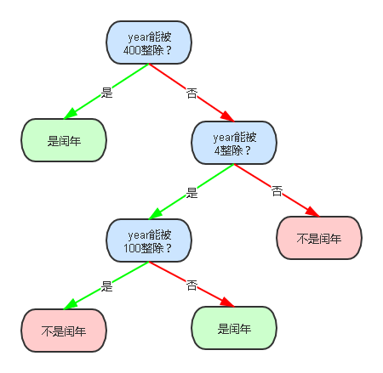
Example - Determining leap years
int year;
cin >> year;
if (year is divisible by 400 )
cout << "yes" ;
else
if (year is divisible by 4 )
if (year is divisible by 100 )
cout << "no" ;
else
cout << "yes" ;
else
cout << "no" ;
int year;
cin >>year;
if (year%400==0)
cout << "yes" ;
else
if (year%4==0)
if (year%100==0)
cout << "no" ;
else
cout << "yes" ;
else
cout << "no" ;

Slide 4
Example - Determining leap years
Test data design
Count how many logical branches are there?
Prepare one test case for each branch
int year;
cin >>year;
if (year%400==0||year%4==0&&year%100!=0)
cout << "yes" ;
else
cout << "no" ;
int year;
cin >>year;
if (year%400==0)
cout << "yes" ;
else
if (year%4==0)
if (year%100==0)
cout << "no" ;
else
cout << "yes" ;
else
cout << "no" ;
(4)
branch | enter | expected output
year%400==0 | 2000 | yes
year%400!=0 and year%4==0 and year%100==0 | 1900 | no
year%400!=0 and year%4==0 and year%100!=0 | 1904 | yes
year%400!=0 and year%4!=0 | 2002 | no

Slide 5
Grammar
if (expression)
Statement 1;
else
if (expression)
Statement 2;
else
Statement 3;
if (expression){
Statement 1;
Statement 2;
}else{
if (expression)
Statement 3;
else
Statement 4;
Statement 5;
}
The structure of nested conditional statements: There is also if-else in the branch of if-else
The syntax requirements for nested if-else are exactly the same
Unlimited levels of nesting are allowed
else always pairs with the nearest if
If you want to change the pairing, you can add curly braces
If-else inside curly braces cannot be paired with those outside
Indentation is usually used for statements after if-else to improve readability.

Slide 6
Example -if and else pairing
int a;
cin >>a;
if (a%3==0)
if (a%5==0)
cout <<a<< " is a multiple of 15 " ;
else
cout <<a<< " is a multiple of 3 but not a multiple of 5 " ;
The structure of nested conditional statements: There is also if-else in the branch of if-else
The syntax requirements for nested if-else are exactly the same
Unlimited levels of nesting are allowed
else always pairs with the nearest if
If you want to change the pairing, you can add curly braces
If-else inside curly braces cannot be paired with those outside
Indentation is usually used for statements after if-else to improve readability.
pair
int a;
cin >>a;
if (a%3==0){
if (a%5==0)
cout <<a<< " is a multiple of 15 " ;
}
else
cout <<a<< " Not a multiple of 3 " ;
Curly braces change the pairing
pair

Slide 7
Example - Output the largest of three numbers
Enter three integers a , b , c
Output the largest number among them
// Error example
What went wrong?
Test Data
int a,b,c ;
cin >>a>>b>>c;
if (a>b&&a>c) cout <<a;
else if (b>a&&b>c) cout <<b;
else if (c>a&&c>b) cout <<c;
Count, how many logical branches are there?
Prepare a test case for each branch
Input: 2 2 3
See what will be output?
The three logical branches do not add up to the whole
Missing the case where two pairs are equal
( 7 )
enter | expected output | Purpose
3 2 1 | 3 | Each is different and a is the largest
2 3 1 | 3 | Each is different and b is the largest
2 1 3 | 3 | Each is different and c is the largest
3 3 2 | 3 | There are two numbers that are the same and a is the largest
2 3 3 | 3 | There are two numbers that are the same and b is the largest
3 2 3 | 3 | There are two numbers that are the same and c is the largest
3 3 3 | 3 | All three numbers are the same
enter | expected output | Purpose
Compare each with other two:
If a is larger than the other two numbers, output a ;
If b is greater than the other two numbers, output b ;
If c is greater than the other two numbers, output c .
// Revision B
// Each branch considers equality situations
int a,b,c ;
cin >>a>>b>>c;
if (a> = b&&a> = c) cout <<a;
else if (b> = a&&b> = c) cout <<b;
else if (c> = a&&c> = b) cout <<c;
// Revision C
// Synthesize the above two modification methods
int a,b,c ;
cin >>a>>b>>c;
if (a> = b&&a> = c) cout <<a;
else if (b> = a&&b> = c) cout <<b;
else cout <<c;
// Revision A
// Change the last else-if to else
int a,b,c ;
cin >>a>>b>>c;
if (a>b&&a>c) cout <<a;
else if (b>a&&b>c) cout <<b;
else cout <<c;
else cout <<c;
correct
correct
Error data : 3 3 2

Slide 8
Example - Output the largest of three numbers
This can be solved by changing the value of the variable:
Define a variable maxn as the largest of the three numbers, and then output maxn .
advantages
Reduce branch nesting and make the logic simple and clear
Take advantage of the feature of the question "It does not require distinguishing which variable is the largest, but only needs to output the largest value"
You can also change a to the largest of the three numbers, and then output a .
Test Data
int a,b,c,maxn;
cin >>a>>b>>c;
maxn =a;
if (b> maxn) maxn =b;
if (c> maxn) maxn =c;
cout << maxn;
int a,b,c;
cin >>a>>b>>c;
if (b>a) a=b;
if (c>a) a=c;
cout <<a;
( 7 )
Count, how many logical branches are there?
Prepare a test case for each branch
enter | expected output | Purpose
3 2 1 | 3 | Each is different and a is the largest
2 3 1 | 3 | Each is different and b is the largest
2 1 3 | 3 | Each is different and c is the largest
3 3 2 | 3 | There are two numbers that are the same and a is the largest
2 3 3 | 3 | There are two numbers that are the same and b is the largest
3 2 3 | 3 | There are two numbers that are the same and c is the largest
3 3 3 | 3 | All three numbers are the same

Slide 9
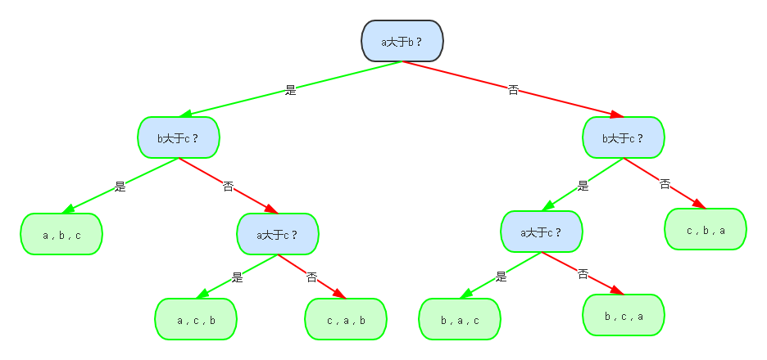
Example - Output three numbers in descending order
Input three integers a , b , c , and output these three numbers in order from large to small.
int a,b,c ;
cin >>a>>b>>c;
if (a>b)
if (b>c)
cout <<a<< "," <<b<< "," <<c;
else
if (a>c)
cout <<a<< "," <<c<< "," <<b;
else
cout <<c<< "," <<a<< "," <<b;
else
if (b>c)
if (a>c)
cout <<b<< "," <<a<< "," <<c;
else
cout <<b<< "," <<c<< "," <<a;
else
cout <<c<< "," <<b<< "," <<a;
Compare the three numbers in pairs, and output them in order from large to small according to the comparison results.
Test Data
(6)
Count, how many logical branches are there?
Prepare a test case for each branch

Slide 10
Example - Output three numbers in descending order
This can be solved by changing the value of the variable:
Change a to the largest of the three numbers, change c to the smallest of the three numbers, and then output a , b , c in sequence .
advantages
Reduce branch nesting and make the logic simpler and clearer
Clarify the order of the final variable values and use the fact variable values can be assigned.
int a,b,c,temp;
cin >>a>>b>>c;
if (a<b){
temp=a;
a=b;
b=temp;
}
if (a<c){
temp=a;
a=c;
c=temp;
}
if (b<c){
temp=b;
b=c;
c=temp;
}
cout <<a<< "," <<b<< "," <<c;
int a,b,c,temp;
cin >>a>>b>>c;
if (a<b)
swap(a,b);
if (a<c)
swap(a,c);
if (b<c)
swap(b,c);
cout <<a<< "," <<b<< "," <<c;
Test Data
Count, how many logical branches are there?
Prepare a test case for each branch
(6)

Slide 11
Branches don’t cover all possibilities
// A set of if-else-if is missing the last else
int a,b,c ;
cin >>a>>b>>c;
if (a>b&&a>c)
cout <<a;
else if (b>a&&b>c)
cout <<b;
else if (c>a&&c>b)
cout <<c;
// There is a ‘lone’ if in the nested if-else, missing the else
int a;
cin >>a;
if (a%3==0){
if (a%5==0)
cout <<a<< " is a multiple of 15 ";
}
else
cout <<a<< " Not a multiple of 3 ";
//Multiple ifs without elses
int a;
cin>>a;
if (a%4==0&&a%400==0)
cout<< "Y" <<endl;
if (a%4!=0)
cout<< "N" <<endl;
if (a%100==0&&a%400!=0)
cout<< "N" <<endl;

Slide 12
Common mistakes
Given an integer, determine whether it is divisible by 3 , 5 , or 7 , and output the following information:
1. It’s divisible by 3 , 5 , and 7 at the same time (directly output 3 5 7, seprated by one space);
2. It’s divisible by two (output 2 numbers, smaller first, followed by the larger. For example: 3 5 or 3 7 or 5 7. Separated by one space);
3. It’s divisible by only one (output the divisor);
4. it’s not divisible by any. output the lowercase character n .
int a;
cin>>a;
if (a%3==0&&a%5==0&&a%7==0){
cout<< "3 5 7" ;
} else {
if (a%3==0&&a%5==0)
cout<< "3 5" ;
if (a%3==0&&a%7==0)
cout<< "3 7" ;
if (a%5==0&&a%7==0)
cout<< "5 7" ;
else {
if (a%3==0)
cout<< "3" ;
if (a%5==0)
cout<< "5" ;
if (a%7==0)
cout<< "7" ;
else
cout<< "n" ;
}
}
Mistakes the last else for a common else for all ifs
Mistakes the last else for a common else for all ifs
based on divisibility by 3, by 5, and by 7, there are 8 scenarios in total. Out results for each scenario.

Slide 13
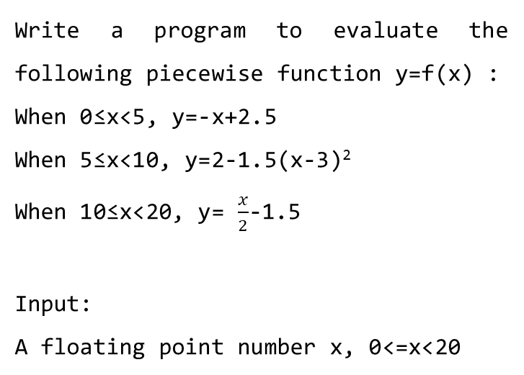
Common mistakes
Write a program to evaluate the following piecewise function y=f(x) :
When 0≤x<5, y=-x+2.5
When 5≤x<10, y=2-1.5(x-3)²
When 10≤x<20, y= $\frac{x}{2}$-1.5
Input:
A floating point number x, 0<=x<20
float x;
cin>>x;
if (0<=x&&x<=5)
cout<<fixed<<setprecision(3)<<-x+2.5;
if (5<=x&&x<=10)
cout<<fixed<<setprecision(3)<<2-1.5*(x-3)*(x-3);
if (10<=x&&x<=20)
cout<<fixed<<setprecision(3)<<x/2-1.5;
There are overlapping ranges that are evaluated in different ifs
For example x is 5 or x is 10

Slide 14
Verify the program
The program has multiple execution branches
Prepare test cases for each branch to ensure that each branch has been executed and is correct
Pay special attention to the boundary cases of conditions and prepare test cases for boundary cases
After modifying the program, it should be retested
You cannot use the training site to verify whether the program passes. You must verify it in DevC++ before submitting the code.

Slide 15
thank you all
Note: Please turn off your microphone and camera
Teacher Gao Algorithm Competition Training Camp

